Slide 1
International Consortium for Telemetry Spectrum
Addressing Telemetry Spectrum Encroachment
Guy Williams
ICTS Regional coordinator Region 2
Luc FALGA ICTS Regional coordinator Region 1
{DISTRIBUTION STATEMENT A. Approved for public release; Distribution is unlimited 412TW-PA-21451]
ITC 2021
Las Vegas, Nevada

Slide 2
Agenda
Introduction
An International issue
2007 A“Banner Year“ for AMT
Current Threats and Challenges
Telemetry Spectrum Protection and the ICTS
Conclusion
Q&A

Slide 3
Introduction
Aeronautical Mobile Telemetry (AMT) forms the lifeline for many scientific and test activities around the world.
Users like, commercial aircraft testing, scientific research, military/weapon testing, atmospheric research, and many other industries are reliant on AMT and the spectrum it requires
AMT is very dependent on the availability of adequate RF spectrum
Especially in the bands below 6 GHz
This part of spectrum is a rapidly being consumed by commercial wireless communications (cell phones, broadband Wi-Fi, …)
• affecting it’s availability for scientific and test activities all over the world

Slide 4
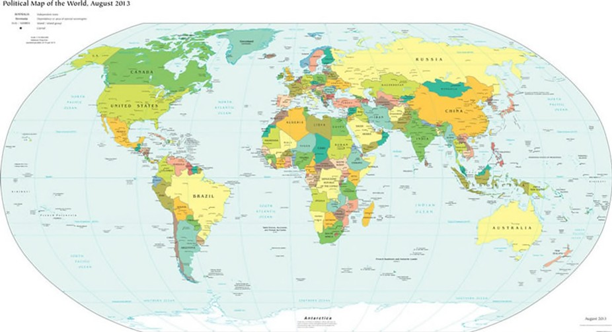
An international issue
Radio frequency ignores borders
International agreements are important
Especially for aeronautical telemetry
Telemetry community must raise awareness of spectrum encroachment
International cooperation
ITU’s Radiocommunications Sector (ITU-R) was established to ensure rational, equitable, efficient and economical use of the radio- frequency spectrum by all radio communication services including:
Effective allocation of bands of the radio frequency spectrum in order to avoid harmful interference between radio stations of different countries
Coordinating efforts to eliminate harmful interference between radio stations of different countries to improve the use of radio- frequencies for radiocommunication services.

Slide 5
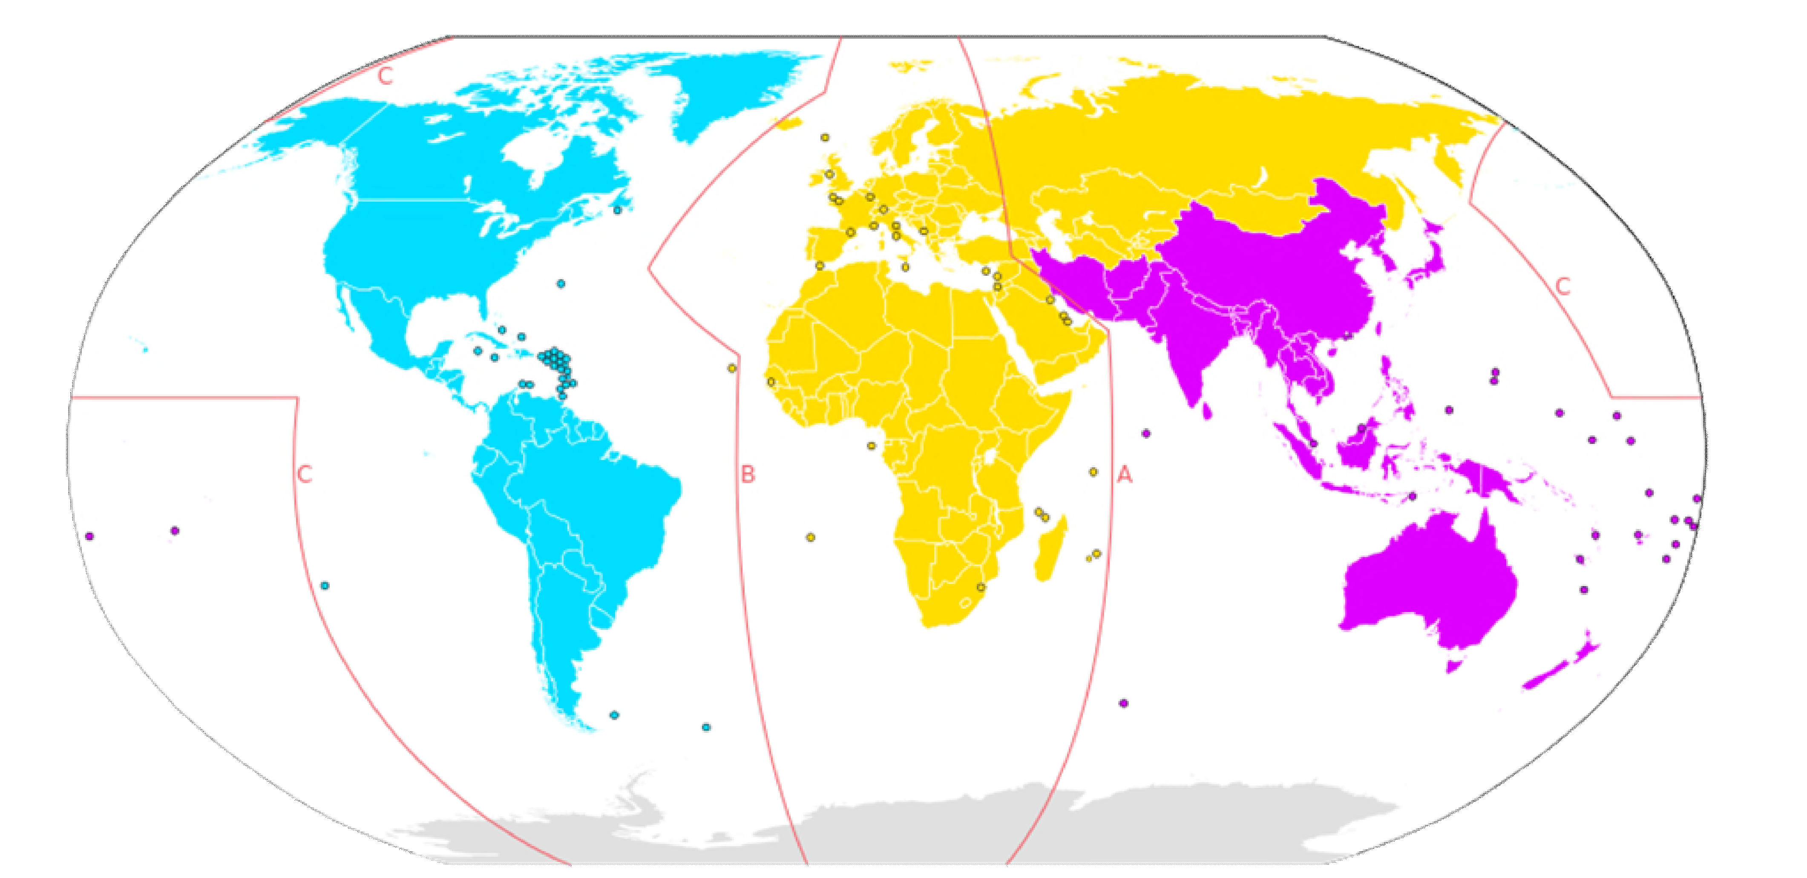
ITU regions
Region 1 : Africa,Europe, Russia
Region 2 : North and South America
Region 3 : Asia, Pacific , Australia
Allocations are described according to the various Regions in the Radio Regulations

Slide 6
World Radio Communication Conference
Every 3 or 4 years
Review and revise international radio Regulations
Revisions based on an agenda : ITU-R Council
Defined at previous conference : 4 to 6 years in advance
Final agenda : 2 years before the WRC
Majority of Member States

Slide 7
World Radio Communication Conference
Terms of ITU Constitution , WRC can :
Revise the Radio Regulations and any associated frequency assignment and allotment plans
Address any radio communication matters of worldwide character
Instruct the Radio Regulations Board , the Radiocommunication Bureau, review their activities
Determine questions for study by the Radiocommunication Assembly and its Study Groups in preparation for future Radiocommunication Conferences

Slide 8
World Radio Communication Conference
Based on contributions from member administrations, Radiocommunication Study Groups and their associated Working Parties, the Conference Preparatory Meeting (CPM) prepare a consolidated report to be used in support of the work of the conferences.
Per the ITU definition, telemetry (Aeronautical Mobile Telemetry or AMT) : a particular use of the mobile service for the transmission from an aircraft station of results of measurements made onboard the aircraft.
At the WRC, AMT is within the ambit of Study Group 5 (Terrestrial Services), and its Working Party 5B (Maritime Mobile Service including the Global Maritime Distress and Safety System (GMDSS), the Aeronautical Mobile Service, and the Radio Determination Service).

Slide 9
World Radio Communication Conference
At the WRC each administration has one vote.
To facilitate the decision process the WRC recognizes six regional organizations to prepare, discuss, and form positions
Region 1 (Europe, Africa, Russia ): CEPT, ATU, ASMG, RCC
Region 2 (North and South America) : CITEL.
Region 3 : Asia , Pacific Australia : APT
Each nation/administration looks to its associated regional organization for support regarding its proposals for the WRC.

Slide 10
World Radio Communication Conference
We, ICTS, must encourage the scientific communities to engage within both their government's communications agencies, their regional alliance, and the ITU-R's Working Parties to protect AMT interests.
Without this advocacy, member administrators will not be able to make informed decisions that accurately represent the telemetry interests (commercial, scientific, government) of their countries and regions.

Slide 11
2007- A“Banner Year“ for AMT
At the 2007 WRC, worldwide telemetry users secured a “global” AMT band.
After a long fought effort to secure additional spectrum for telemetry that started in 1993, the global scientific community was recognized for its economic and scientific value and additional allocations were approved.
As one of the outcomes to Agenda Item 1.5 at the WRC in 2007, spectrum in three additional bands was provided for AMT, one of these on a global basis, i.e. 5091 MHz to 5150 MHz. See ITU Radio Regulation 5.444B and Resolution 418 as revised.
Note that this band is also allocated for the aeronautical mobile (route) service (e.g. airport surface communications systems) which has priority; domestic implementation decisions are important here.

Slide 12
2007- A“Banner Year“ for AMT
The two additional bands identified for AMT are 4400-4940 MHz in most Region 2 countries and in Australia; and 5925-6700 MHz in Region 2 countries. See Radio Regulations 5.440A, 5.457C, and Resolution 416 (WRC-07) for details.
Scientific, commercial, and government flight test communities are highly encouraged to make use of the additional spectrum.
Many telemetry vendors have developed transmitters, receivers, and antennas for one or more of these three bands.
Given the demand for mobile broadband spectrum, and the competition for spectrum access, ICTS members should seek allocation of one or more of these bands within their countries, or find it unavailable domestically.

Slide 13
Current Threats and Challenges
World Radiocommunication Conference 2019 : from 28th of October to November 22nd, in Sharm El-Sheikh, Egypt
The Conference was attended by 3000-some delegates from nations around the world.
The Conference identified :
over 15 GHz of globally harmonized millimeter wave spectrum for 5G
spectrum for high-altitude platform stations (“HAPS”)
spectrum for constellations of hundreds or even thousands of new satellites
spectrum for earth stations in motion communicating from aircraft
maritime vessels and vehicles on land with satellites in geostationary orbit
spectrum for wireless access systems, including radio local area networks.
The Conference expanded
coverage of the Global Maritime Distress and Safety System in Polar regions
improved flight tracking with an updated Global Aeronautical Distress and Safety System

Slide 14
Current Threats and Challenges
No items on the agenda dealing expressly with Aeronautical Mobile Telemetry
Recommendation (ITU-R M. 2122) was approved early last year, focuses on the band 5150-5250 MHz in ITU Region 1 (Europe, Africa, and the Middle East), as well as in Brazil.
Care was taken during the work on the document to ensure that it not compromise long-standing ITU-R Recommendation M. 1459 which continues to provide important protection for AMT in other parts of the world and other spectrum ranges.
WRC-19 adopted an ambitious provisional agenda for the next Conference in 2023
Items include :
measures to address protection of the aeronautical mobile service in the band 4800- 4990 MHz
possible identification of additional spectrum in the 3 and 6 GHz ranges for international mobile telephony
development of regulatory provisions to facilitate communication for sub-orbital vehicles
new allocations for the aeronautical mobile service.

Slide 15
Telemetry spectrum Protection and ICTS
The International Consortium for Telemetry Spectrum strives to inform the international telemetering community of vital issues that we all need to monitor and alert members as needed to preserve this critical scientific capability.
ICTS monitors and reports on regional and international telecommunications regulation and policy activities that could affect this community.
If you develop, use or rely on radio frequency (RF) telemetry, you should engage in the development of these international regulations and policy decisions that could affect you locally.
The ICTS was formed in 1999 and is chartered under the sponsorship of the International Foundation for Telemetering (IFT).
The IFT is a non-profit organization dedicated to serving the professional and technical interests of the telemetering community.

Slide 16
Telemetry spectrum Protection and ICTS
Over the past few years, several factors within and external to the telemetering community have resulted in a change in the way the electromagnetic spectrum is viewed.
These factors include:
Commercial RF spectrum utilization is increasing rapidly and this trend will continue
Frequency bands used for telemetry continue to be at risk of reallocation and interference
Telemetry data rates are increasing, thereby increasing the RF bandwidth needed
We are caught in the midst of these trends as we seek to keep pace with the extraordinary growth in telemetry data being required of test programs
The purpose of the ICTS is to establish an international information exchange of telemetry practitioners to promote and defend the benefits of electromagnetic spectrum utilization for scientific telemetering applications.
In this endeavor, the main objective of the ICTS is to create a forum for information exchange on potential telemetry spectrum issues

Slide 17
Telemetry spectrum Protection and ICTS
We, the telemetry community, need to better inform national, regional, and international spectrum managers of the importance of telemetry to their economy and security
ICTS seeks to inform and invite open participation in the group to all telemetry practitioners, including government, industry, academia, etc. by sharing information on the use, research, and development of new technologies for improving the use of telemetry spectrum
ICTS seeks to prepare members for World Radiocommunications Conference (WRC) agenda items affecting the telemetry community
ICTS attends and support the European Test and Telemetry Conference (location rotates between France and Germany) and the International Telemetering Conference (USA).
These Conferences will showcase original technical papers and innovation ideas in test, telemetry, telecontrol, instrumentation and recording technologies for industrial, automotive, scientific, aerospace, space, naval and military applications.

Slide 18
Telemetry spectrum Protection and ICTS
ICTS encourages participation from the general population in both attendance and presentations related to AMT spectrum.
Membership is not required to participate
ICTS is available to help
ICTS has points of contacts in many nations who are willing to answer questions, provide information, and develop presentations to assist the international telemetry community.
Through ICTS connections, we can put you in touch with subject matter experts and a wealth of library information on many aspects of telemetry.

Slide 19
Conclusion
Contact us :
– via email ICTS@telemetryspectrum.org
– visit our website at www.telemetryspectrum.org.

Slide 20
Conclusion

Slide 21
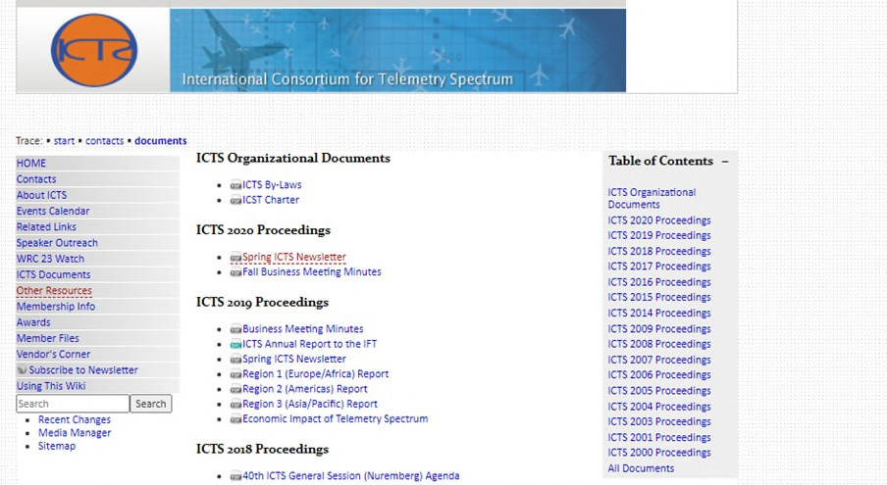
Conclusion

Slide 22
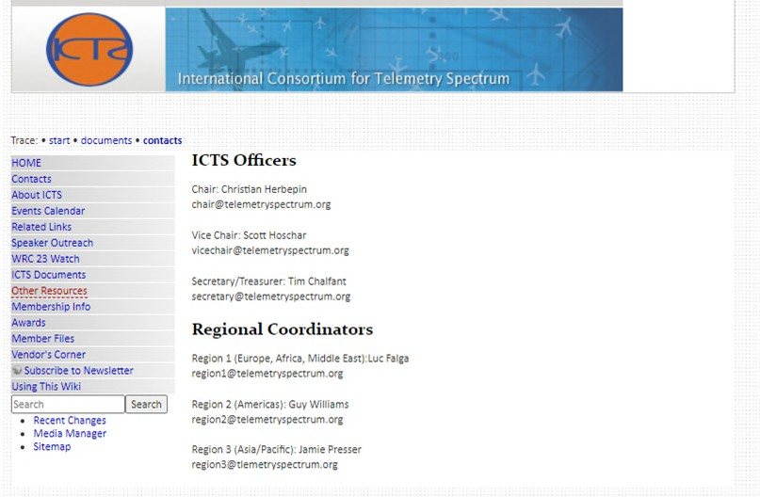
Conclusion

Slide 23
Conclusion
Our silence can be damaging !
The ICTS stands ready to help and serve the international telemetering communities to become loud!

